Slide 1
Book recommender bot
Kattabekov Beknur
Sadir Aigerim,
Turekul Nurgalam

Slide 2
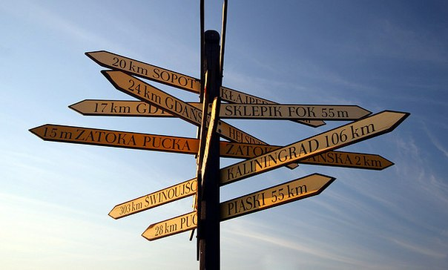
Too many choises

Slide 3
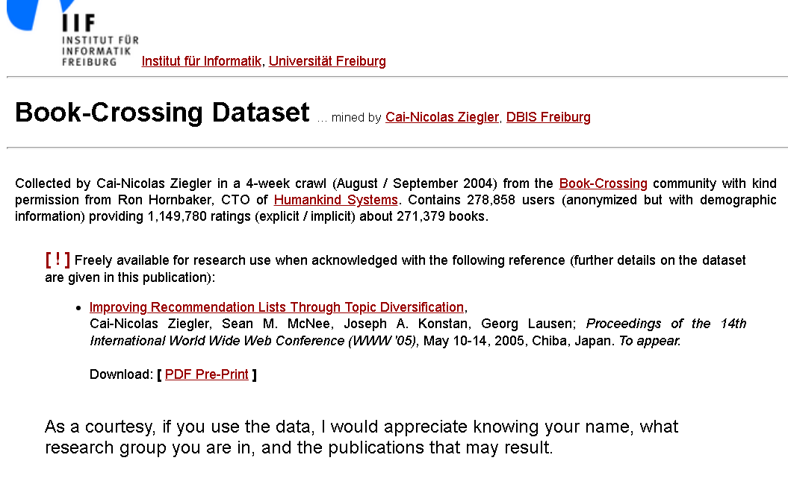
Let’s start with the first set of slides

Slide 4
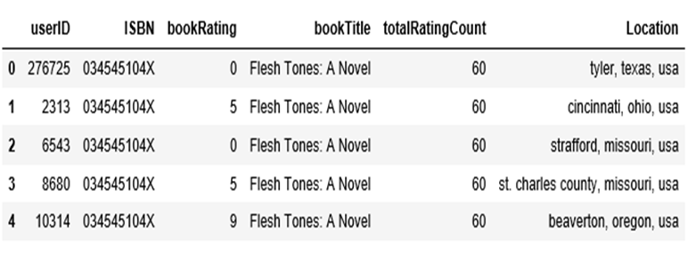
Books.head()

Slide 5
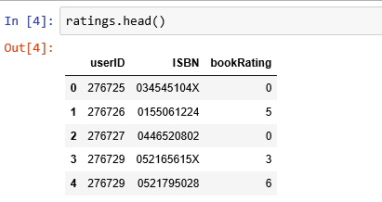
.

Slide 6
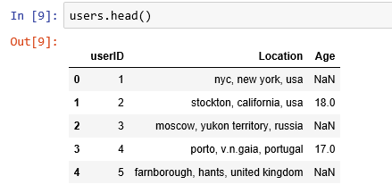

Slide 7
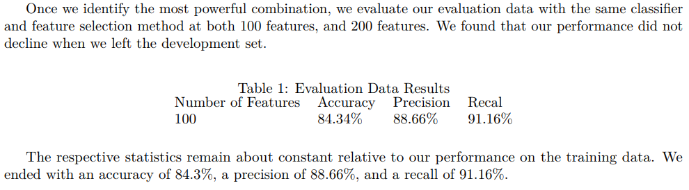
Accuracy of book recommender system
...and we hope to have the same result

Slide 8
Implemetation
Collect the dataset with book content
Find most correlated samples
LDA and wordnet for top correlated books
Wrap up algorithms in the bot

Slide 9
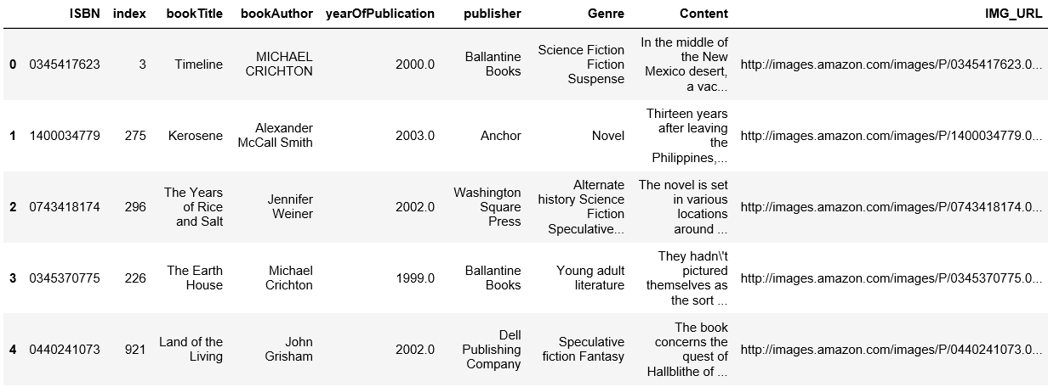
Collect the dataset with book content

Slide 10
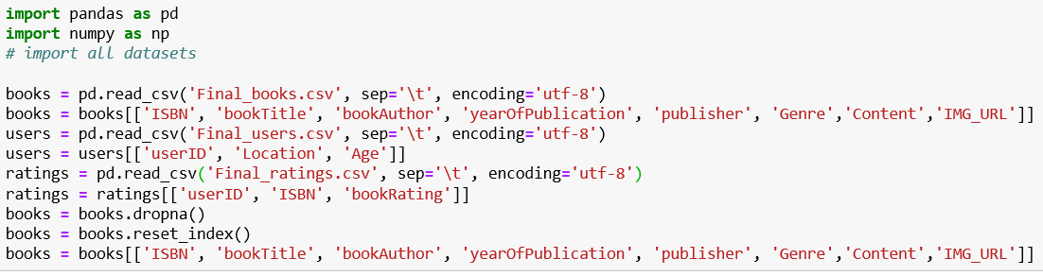
Find most correlated samples

Slide 11
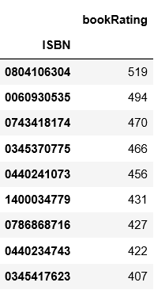
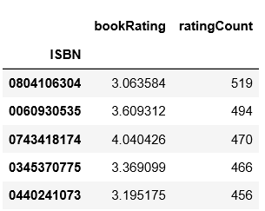

Slide 12
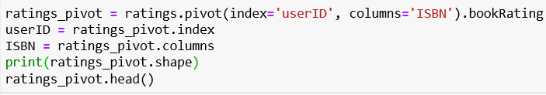
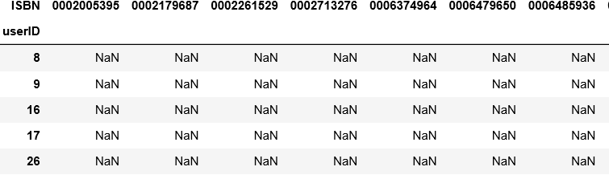

Slide 13
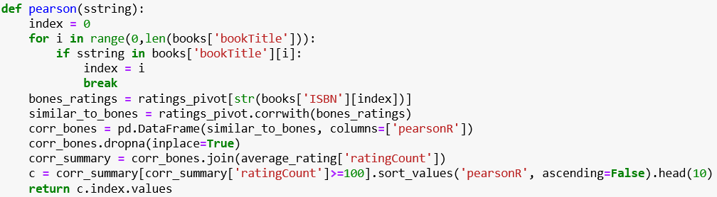

Slide 14
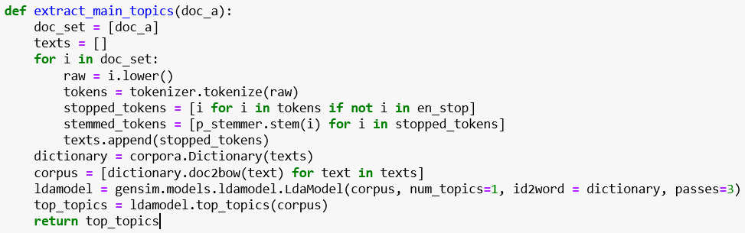
LDA and wordnet for top correlated books

Slide 15
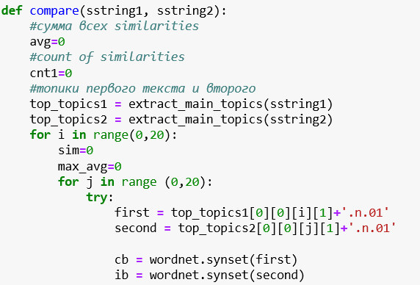


Slide 16
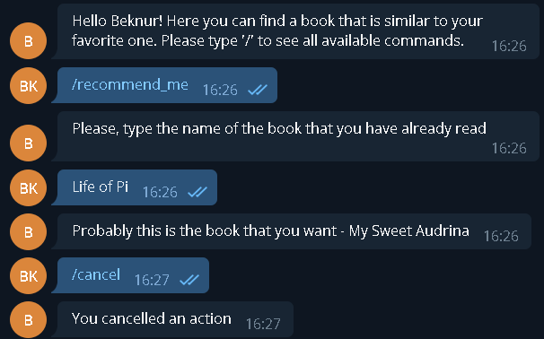
Wrap up algorithms in the bot

Slide 17
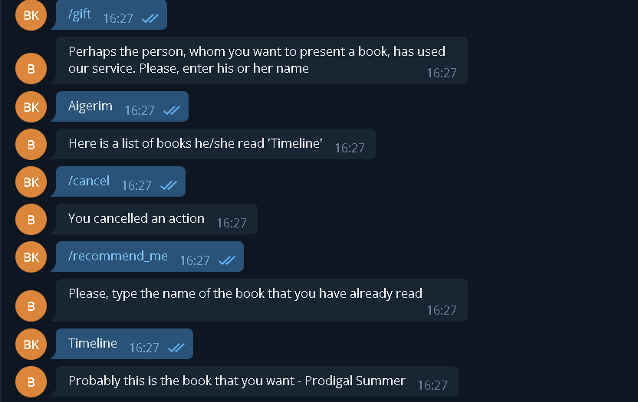

Slide 18
What do we get from this project?
No stresses in finding what to read next.
No need to search for similar books
Bot can recommend you what to present someone, according to the book he\she has read

Slide 19
Thank you for your attention!

